Slide 1
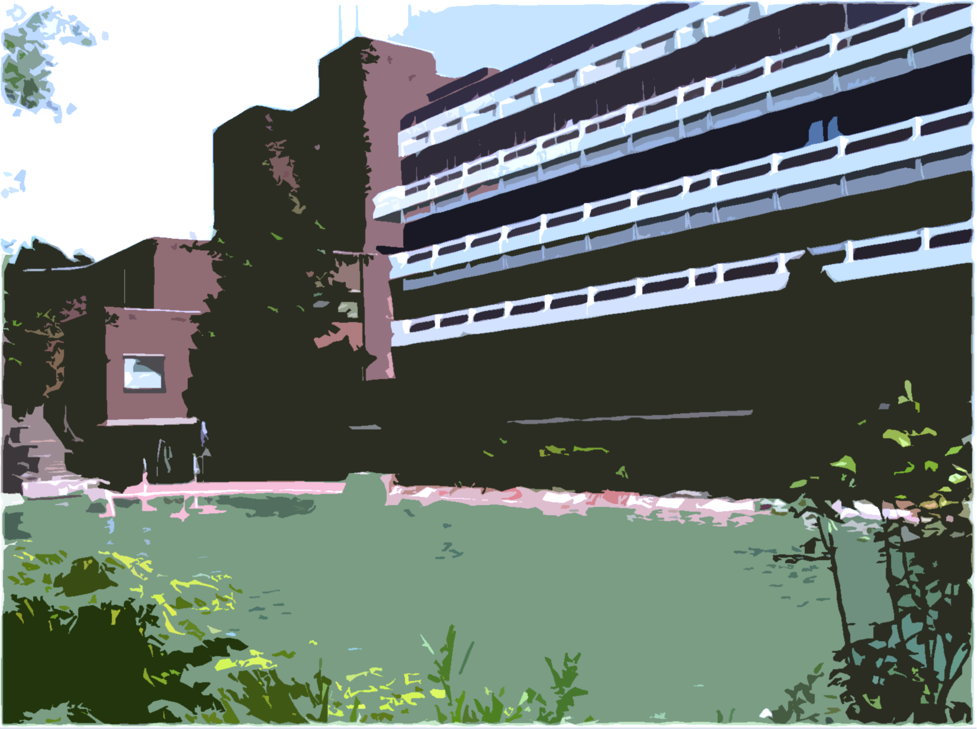
Laboratory of Plant Physiology and Molecular Genetics

Slide 2

Toxic elements - Cadmium
Our aim is to decipher Cd accumulation and detoxification pathways
Passage of metals from soil to plant
Mechanisms of tolerance and accumulation
Study of metal hyperaccumulation reveals key nodes of the metal homeostasis network that, when altered, lead to drastic changes in metal accumulation and tolerance
detoxification of TME
Distribution
unloading of TME
Translocation
translocation of TME to shoots
uptake systems of TME
Absorption
Enhanced processes
In hyperaccumulators
TME: Trace metallic element
Notes:
Main mechanisms involved in hyperaccumulation include efficient uptake, efficient loading and unloading from the xylem, efficient detoxification in the shoots

Slide 3
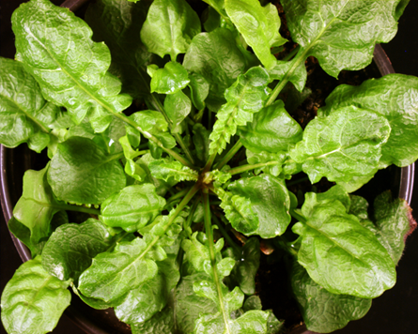
Arabidopsis halleri
Populations studied
Hybrid zone:
PL34 (NM) - Poland
PL22 (M) - Poland
South-east zone:
I30 (NM) - Italy
I16 (M) - Italy
Notes:
Les différentes populations d’A. halleri appartiennent à des unités génétiques distinguent au sein desquelles de populations métallicoles ont évolué à partir de populations non métallicoles. NOUS éTUDIONS EN PARTICULIER 4 POPULATIONS PRéSENTANT DES NIVEAUX DE TOLéRANCE ET D’ACCUMULATION DU CD CONTRASTéS. Le mémorant particpera … (à lire)

Slide 4
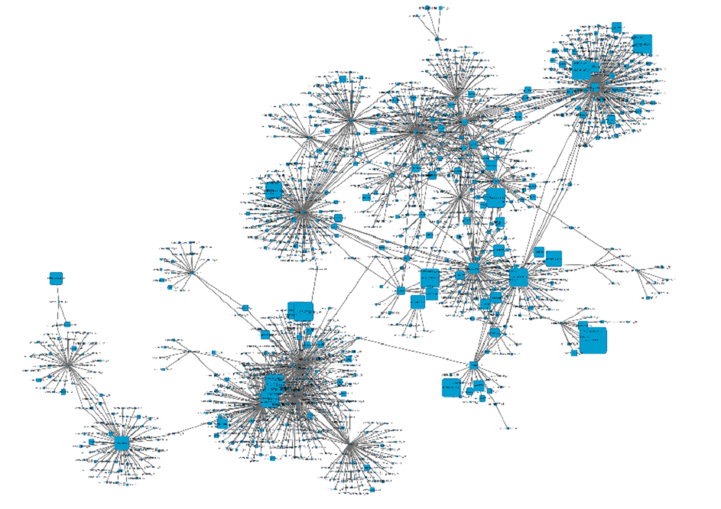

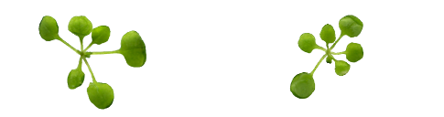
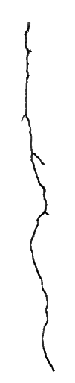

Genes, Metabolites and Network analyses
Network analysis: Genes that showed similar expression patterm
Growth test on knockout mutants
(they DO NOT express a gene of interest)
Cd treatment
WT
Mutant
Oxidative stress
WT
Mutant

Slide 5
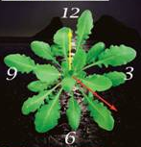
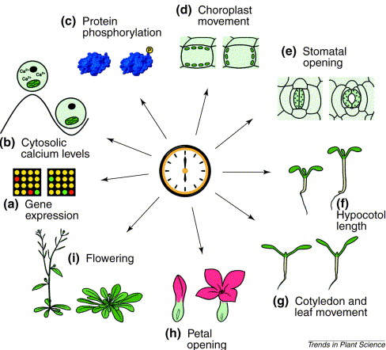
Plant Circadian Clock
= ~24 hours

Slide 6






Gene expression analysis by Luminescence

Slide 7
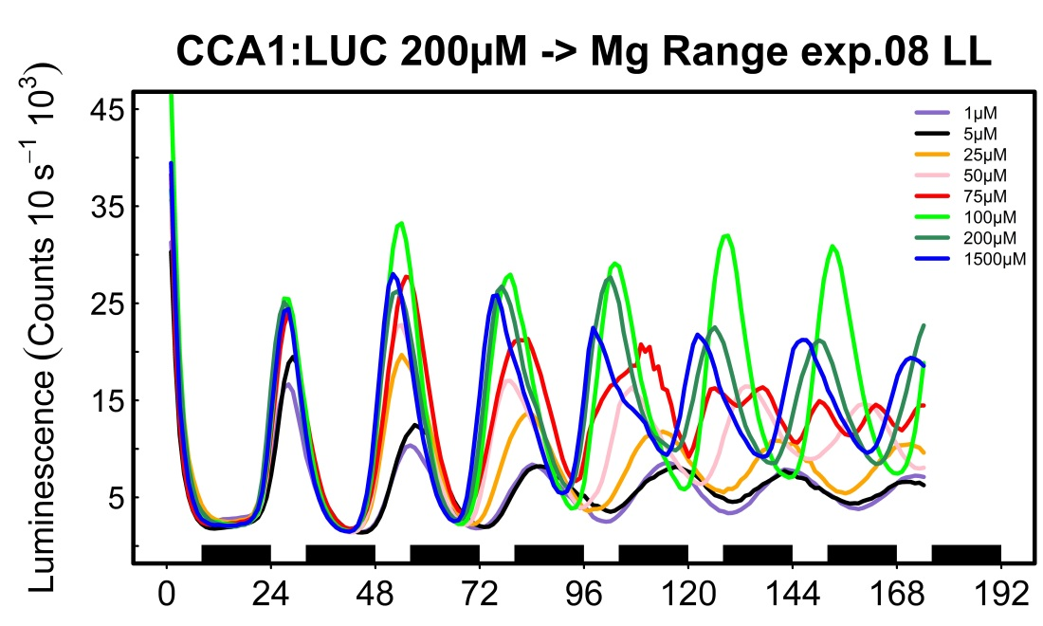
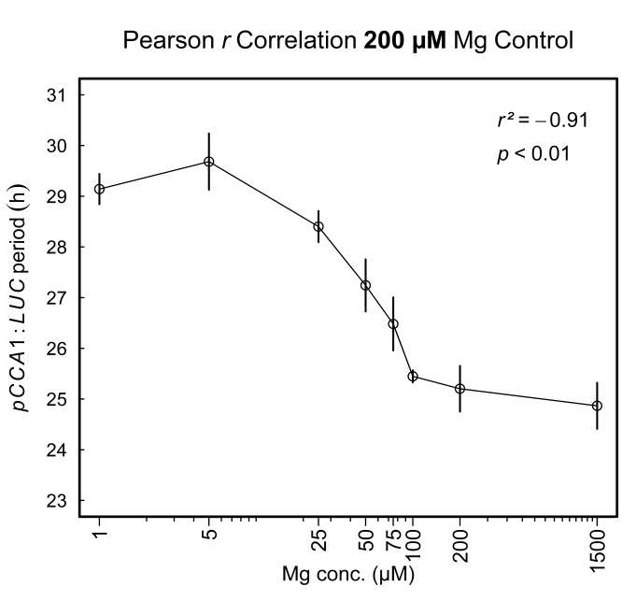
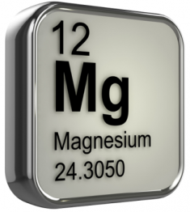
Mg and circadian oscillations
Luminescence of plant CCA1 promoter
***
***
***
**
ns
ns
* p < 0.05
** p < 0.01
*** p < 0.001
ns
= ~24 hours
= ~30 hours
Melo etal 2016 unpublished

Slide 8
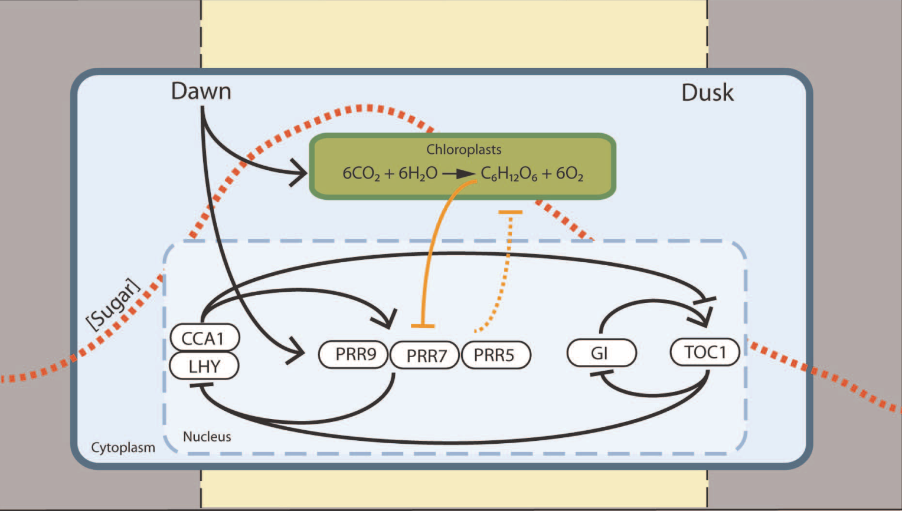
Role of circadian clock in
plant adaptation to mineral stress
Masters thesis: Analysis of clock components involved in Mg deficiency response
?
Haydon etal 2013 Nature 502:689–692

